Slide 1
John T Conroy
Environmental
Project
Management
Notes:
Slide Number 1
Introduce Urban Engineers
Hired by DOA for design of Apron E reconstruction
Informal as possible - ask questions as they arise.
Why reconstruct?
Alkali-silica reactivity between aggregates and concrete
Result - progressive deterioration of concrete surface starting at the joints and slowly proceeding inward
Hazard - FOD
Temporary bituminous repairs made

Slide 2
John T Conroy Education & Training
Bachelor of Science (BS) – Community Development & Planning – Man/Environment Relations (MER)
Master of Science (MS) Environmental Resource Management
Post Graduate
Forest Stewardship
US Department of Transportation (USDOT) - National Environmental Policy Act (NEPA) Environmental Training Center (ETC) graduate
US Fish & Wildlife Service (USFWS) Habitat Evaluation Procedures (USHEP)
PA Game Commission (PGC) – Habitat Evaluation (PAMHEP)
US Army Corps of Engineers (USACE) & PA Department of Environmental Protection (PADEP) Wetland Delineation and Waterways Encroachment Permit Training
PADEP Erosion & Sedimentation and Storm Water Management Control
Safe Land-USA Certification
Dale Carnegie Speech & Effective Communication

Slide 3
Memberships & Affiiations
Marcellus Shale Coalition (MSC), Legislative & Environmental Committees
Pennsylvania Independent Oil & Gas Association (PIOGA), Environmental & Safety Committees
Society of Wetland Scientists (SWS)
Association of State Wetland Managers (ASWM)
PA Alliance of Environmental Professionals (PAEP)
PA Recreation & Park Society (PRPS)
Oil Region Alliance of Business, Industry & Tourism (ORA)
American Society of Civil Engineers (ASCE) & Association of State Highway Engineers (ASHE)
Previous appointment to the Governor’s PADEP Pipeline Infrastructure Task Force (PITF) – Natural Resources Work Group.

Slide 4
Attributes
Leadership Skills Developed Over the Years
Ability to see the “big picture”
Long range planning
Attention to detail
Organizational skills
Good communicator (Ability to relate to professionals from various disciplines and the public.)

Slide 5
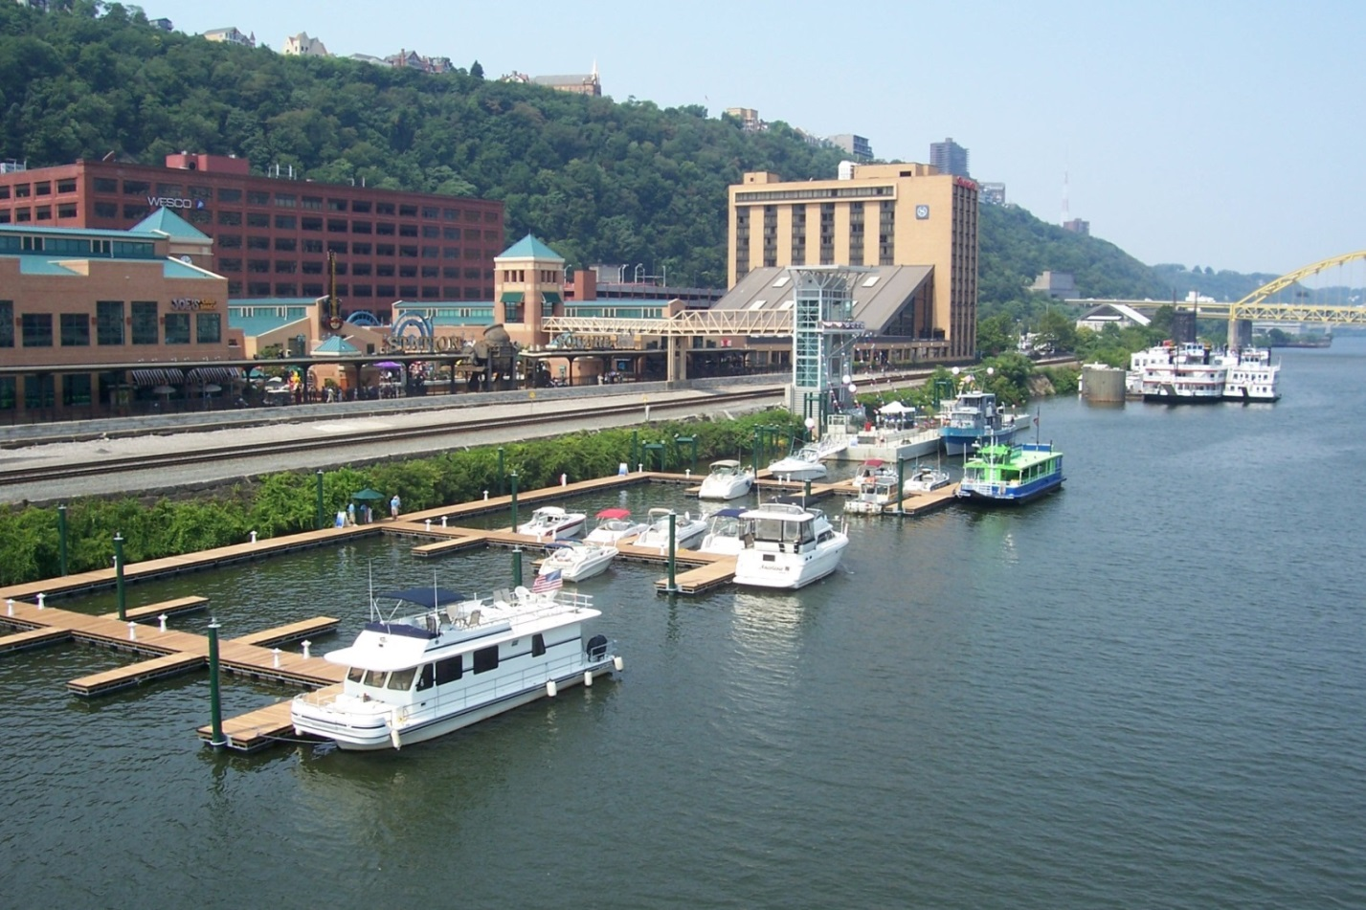
Castaway Riverboat Landing & Marina at Station Square Project Manager while at TriLine/PBSJ
Challenges
Safety
Accessibility
ADA Compliance
100 Year Floodplain
6.5 mph River Flow
Snow, Wind, and Ice Load
Ice & debris flow
Geotechnical
Historical resources
Water quality
Land use, aesthetics & compatibility

Slide 6
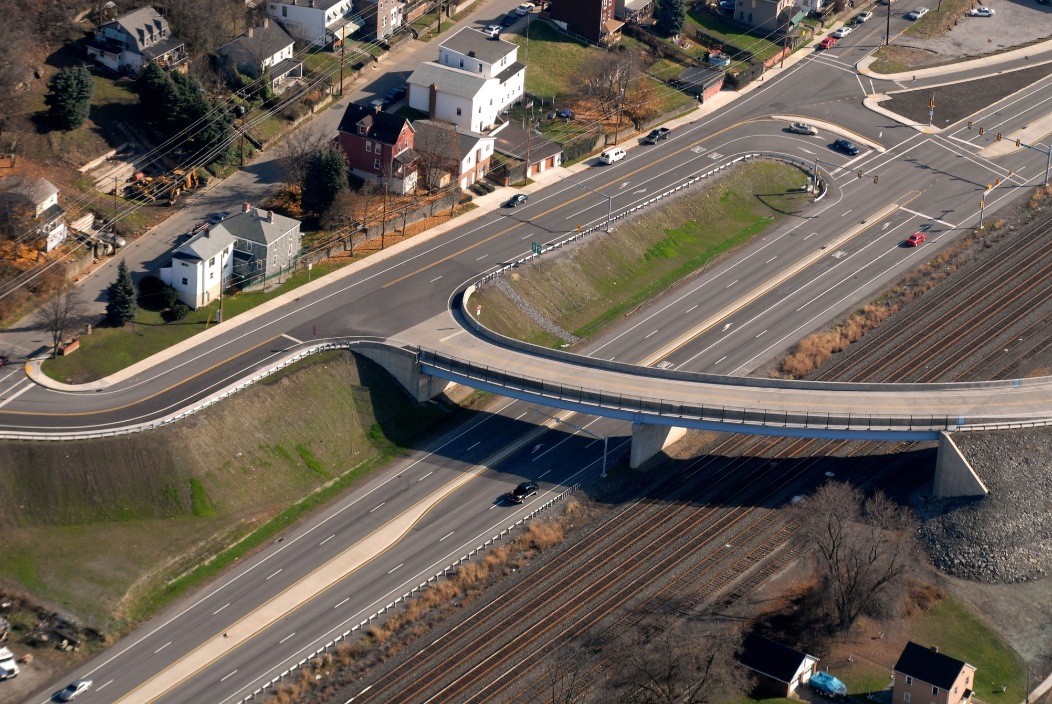
Leetsdale Overpass Environmental Manager - TriLine

Slide 7
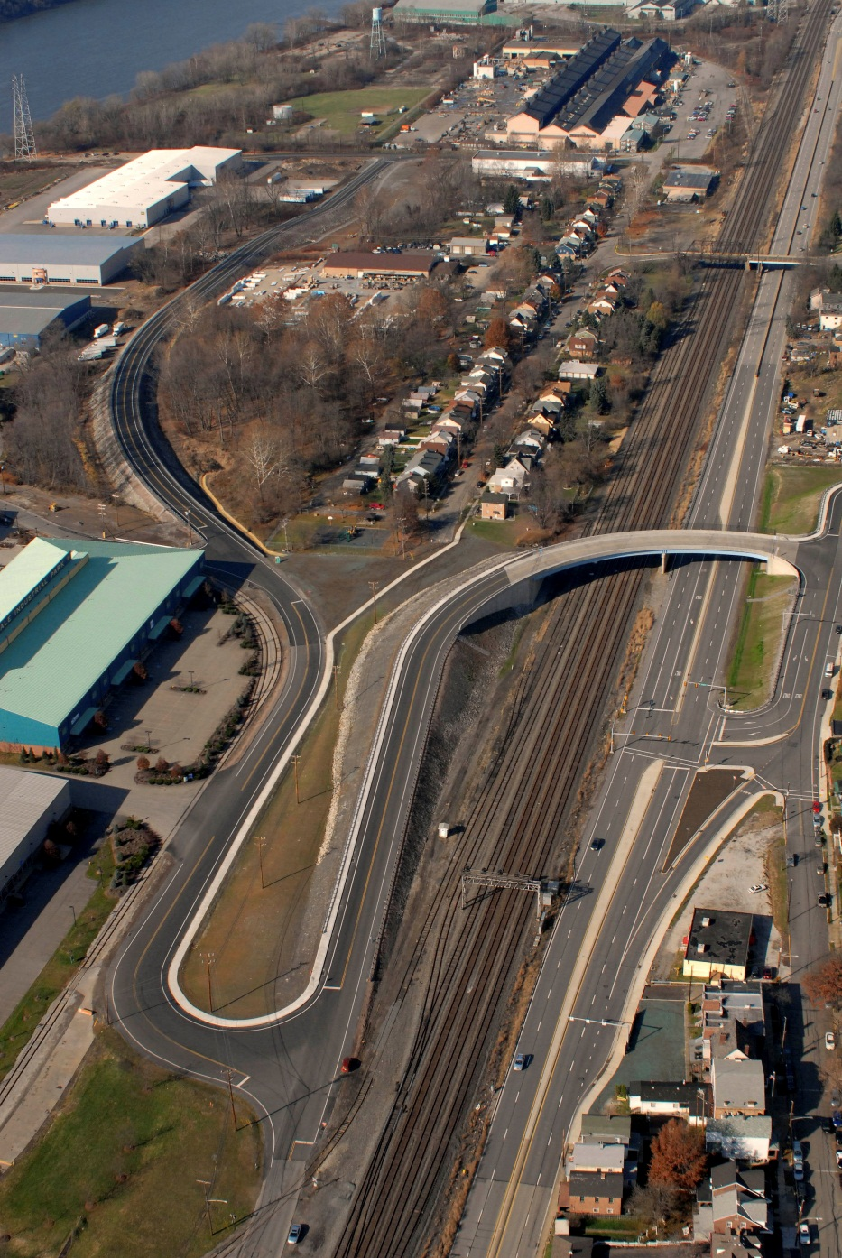
Leetsdale Overpass Challenges
Hazardous Waste
Underground Storage Tanks (UST)
Industrial Residue
Social
Residential Displacements
Commercial Displacements
Buncher Industrial Park
Transportation Safety
Pedestrian
CSX Railway
Traffic
Environmental
Streams
Wetlands
Noise
Air Quality
Cultural Resources
Historic
Archaeological
Recreation
Park (4f)
PFBC Boat Launch

Slide 8
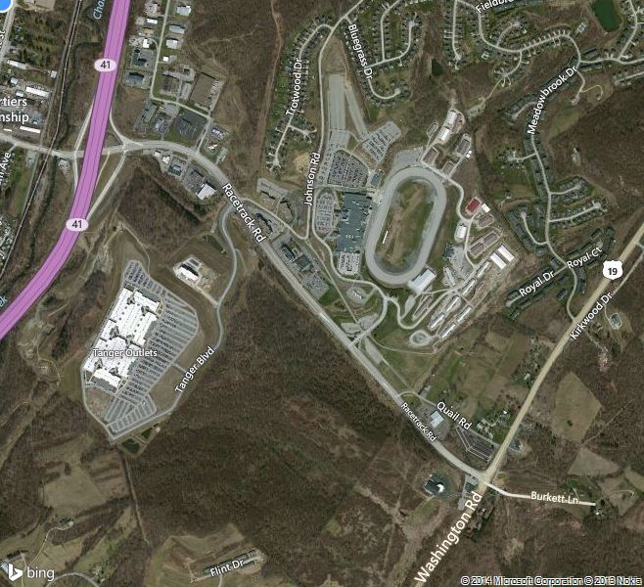
Land Development Site Work Design & Transportation Issues
NEPA Categorical Exclusion
Evaluation
Wetland delineation & mitigation, stream restoration, waterways encroachment permitting

Slide 9
Butler-Freeport Trail Planning, Design, & Construction, Project Manager - TriLine
Client: Freeport Borough Funding
PADCNR, USDOT (PennDOT 10-0)
Project Cost: 1.2 million
Planning, Environmental Clearance, Preliminary & Final Design & Construction for lower 3.2 mile section

Slide 10
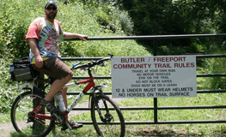
Lower Section of Butler-Freeport Trail
Located in an Audubon designated Important Bird Area (IBA)
Design included links to Freeport commercial district, Freeport Bridge, and new parking lots.

Slide 11
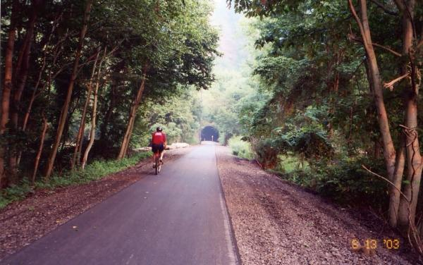
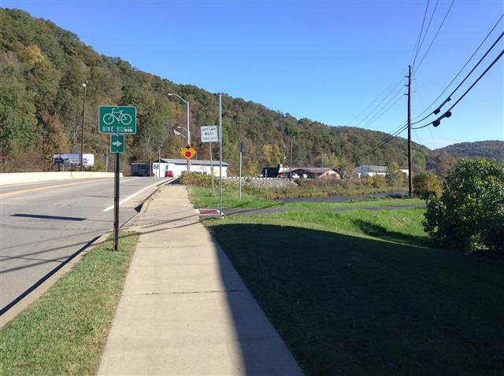
Project Manager - McClintock Trail -Linking Oil City with Oil Creek State Park & McClintock Well National Historical Site – TriLine/PBSJ & Urban
Client & Year: ORA & AVTA (2009-12)
Funding: PADCNR, USDOT (PennDOT 1-0)
Design & Construction Management Fee: $320K
Project Cost: 1.2 million
Project Manager for Planning, Environmental Clearances, Preliminary & Final Design and Construction Inspection
.

Slide 12
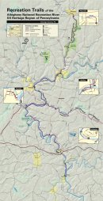
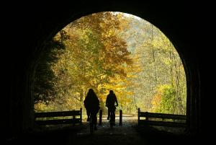
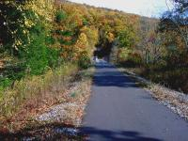
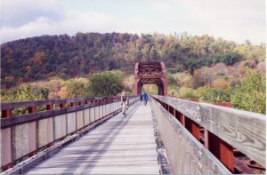
Project Manager - Oil Region Alliance of Business, Industry & Tourism (ORA) – TriLine/PBSJ
Trail Utilization Study: Socio-Economic Impact Analysis of the trail systems within the Oil Heritage Region
http://www.avta-trails.org/AVTA-Study-2006.html
Client: ORA & AVTA
Funding: PADCNR & AVTA
Fee: $62,000
Financed in part by a Pennsylvania Heritage Areas Program Grant from the PA Department of Conservation and Natural Resources, Bureau of Recreation and Conservation, via the Oil Region Alliance of Business, Industry, and Tourism (ORA). Matching funds were provided courtesy of the Allegheny Valley Trails Association (AVTA).

Slide 13
Project Manager - Restoration of Pittsburgh Parks – TriLine
Client: Pittsburgh Parks Conservancy (2008-2010)
Total Project Cost: $3.8 million
Design Fees: $380,000
Improved 6 miles of trails throughout the City of Pittsburgh’s four regional parks (Schenley, Highland, Riverview, and Frick.
Funding: In order to access the federal funding, the Pittsburgh Parks Conservancy (PPC) raised approximately $700,000 through matching donations from the Pittsburgh community, the Pennsylvania Department of Conservation and Natural Resources, local foundations and corporations.
In addition to 6 miles of new trails, the project included:
Connecting broken trail segments, including rebuilding several stone bridges
Trail surfaces were repaired while stormwater inlets and drainage pipes were cleaned, repaired or replaced
Water gardens, wetland, and infiltration were used to control runoff
In addition to directional signs, new interpretive signs provide information about park history, wildlife, and restoration projects that have improved the parks.
Restoration of historical Work Progress Administration (WPA) era projects (walls, bridges, steps)
Coordination with Pittsburgh Historic Landmarks, USACE, PADEP

Slide 14
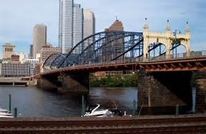
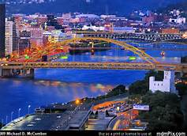
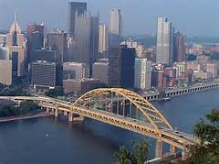
Environmental manager for the following significant bridge restoration projects in Pittsburgh requiring NEPA clearances
Smithfield Street Bridge
South Tenth Street Bridge
Fort Pitt Bridge & Tunnel Restoration

Slide 15
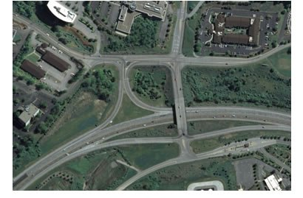
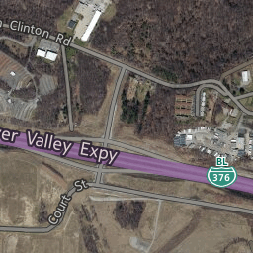
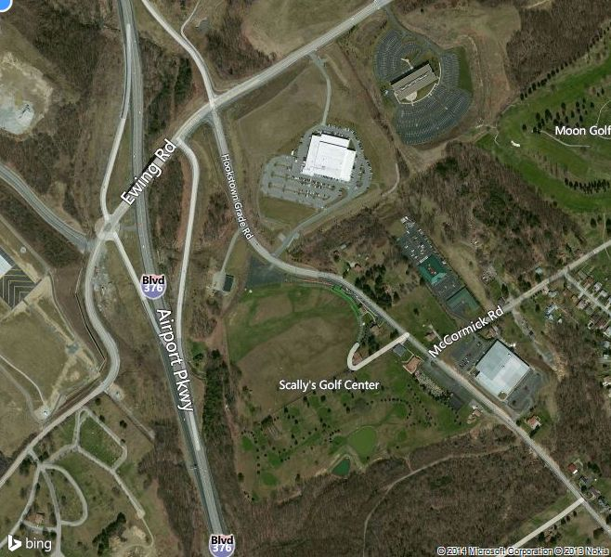
Transportation – Environmental manager for significant improvements to Business I-376 (Business Route 60 & Beaver Valley Expressway)
Thorn Run Interchange
NEPA Environmental Assessment (EA)
Ewing Interchange NEPA FEIS Revaluation
Cargo Interchange
NEPA Categorical Exclusion Evaluation (CEE)

Slide 16
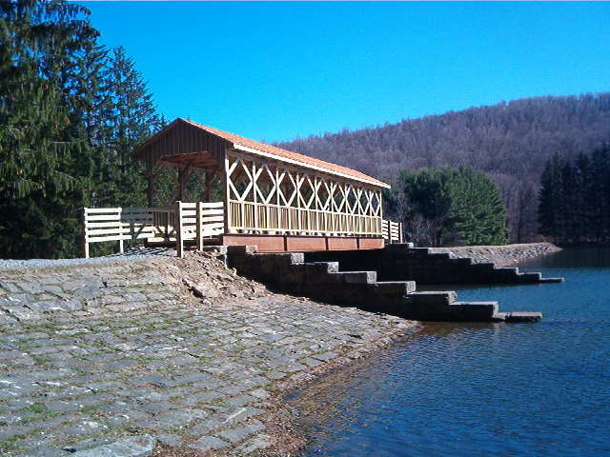
Project Manager for City of Bradford, PA. Office of Economic & Community Development (OECD) Community Trails – PBSJ/TriLine
Community Parks Trail, completed in 2012
Project manger for planning, environmental clearances (NEPA CEE), preliminary & final design.
Passes through the University of Pittsburgh Kessel Athletic Complex and Callahan Park
Connects the McDowell Community Trail to the City’s downtown Historic District via the Pine Street Pedestrian Bridge.
Recently renovated Hanley Park also connects to the Community Parks Trail.
Final connecting leg of the Community Parks Trail was completed in 2016. The 0.4 mile trail connected Hanley Park to the 3.3 mile urban trail connecting Kessel Athletic Complex and Callahan Park.

Slide 17
Ultimately protection and restoration of our environment is up to all of us!

